Slide 1
Software Design Principles
Lecturer: Ngo Huy Bien
Software Engineering Department
Faculty of Information Technology
VNUHCM - University of Science
Ho Chi Minh City, Vietnam
nhbien@fit.hcmus.edu.vn

Slide 2

Objectives
To use software design principles to evaluate a design.

Slide 3

Contents
Object Creation.
The Single Responsibility Principle.
The Open/Closed Principle.
The Liskov Substitution Principle.
The Dependency Inversion Principle.
The Law of Demeter Principle.
GRASP.

Slide 4

References
Robert C. Martin (2000). Design Principles and Design Patterns.
Steve McConnell (2004). Code Complete, Second Edition.
Robert C. Martin (2003). Agile Software Development: Principles, Patterns, and Practices. Pearson.
Robert C. Martin (2017). Clean Architecture - A Craftsman’s Guide to Software Structure and Design. Pearson Education.
Gary McLean Hall (2014). Adaptive Code via C#: Agile Coding with Design Patterns and SOLID Principles. Microsoft Press.
Craig Larman (2004). Applying UML And Patterns. 3rd Edition. Prentice Hall.

Slide 5

Why Software Design Principles?

Slide 6
Symptoms of Rotting Design [1]
Rigidity is the tendency for software to be difficult to change, even in simple ways.
Fragility is the tendency of the software to break in many places every time it is changed.
Immobility is the inability to reuse software from other projects or from parts of the same project.
When the design preserving methods are harder to employ than the hacks, then the viscosity of the design is high.
Viscosity of environment comes about when the development environment is slow and inefficient.

Slide 7


Slide 8
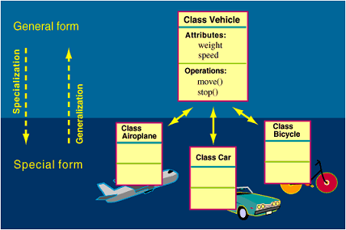
When to Create a New Class? [2]
Model real-world objects
Model abstract objects
Reduce complexity
Isolate complexity
Hide implementation details
Limit effects of changes
Streamline parameter passing
Facilitate reusable code

Slide 10
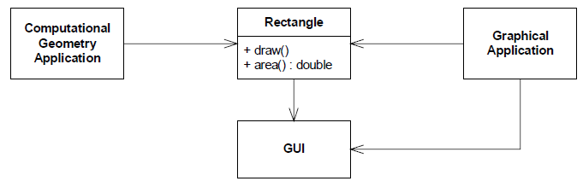


The Single Responsibility Principle [3]
A class should have only one reason to change.
The first responsibility is to provide a mathematical model of the geometry of a rectangle.
The second responsibility is to render the rectangle on a graphical user interface.

Slide 11
Problem
We must include the GUI in the computational geometry application.
If a change to the Graphical Application causes the Rectangle to change for some reason, that change may force us to rebuild, retest, and redeploy the Computational Geometry Application. If we forget to do this, that application may break in unpredictable ways.

Slide 12
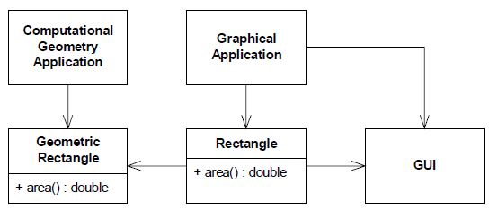
One Solution
We must include the GUI in the computational geometry application.
If a change to the Graphical Application causes the Rectangle to change for some reason, that change may force us to rebuild, retest, and redeploy the Computational Geometry Application. If we forget to do this, that application may break in unpredictable ways.

Slide 13
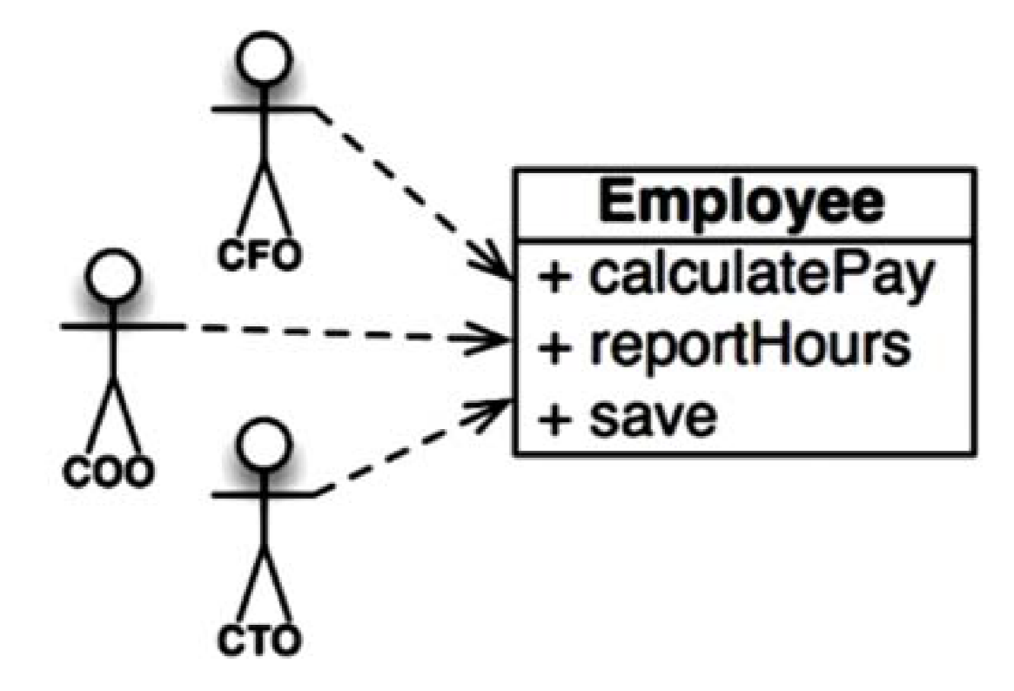
Another Version of the SRP [4]
A module should be responsible to one, and only one, actor.
This class violates the SRP because those three methods are responsible to three very different actors.
The calculatePay() method is specified by the accounting department, which reports to the CFO.
The reportHours() method is specified and used by the human resources department, which reports to the COO.
The save() method is specified by the database administrators (DBAs), who report to the CTO.

Slide 14
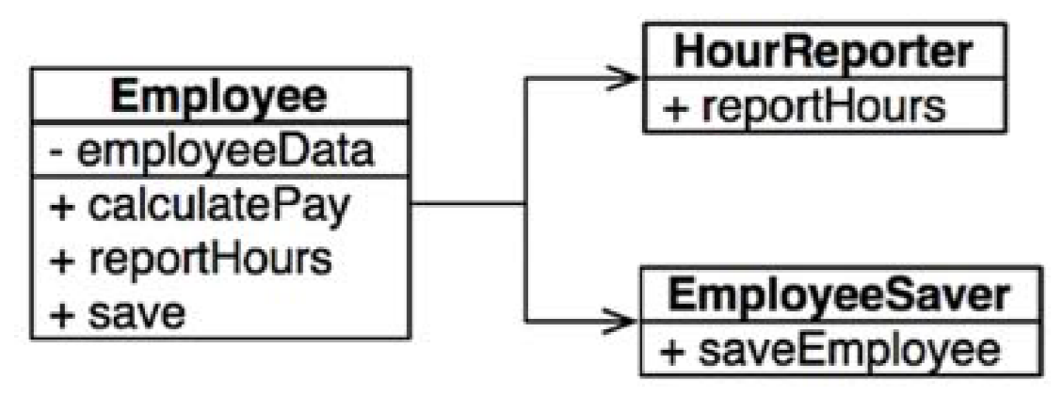
One Solution
This can be done by keeping the most important method in the original Employee class and then using that class as a Facade for the lesser functions.

Slide 15
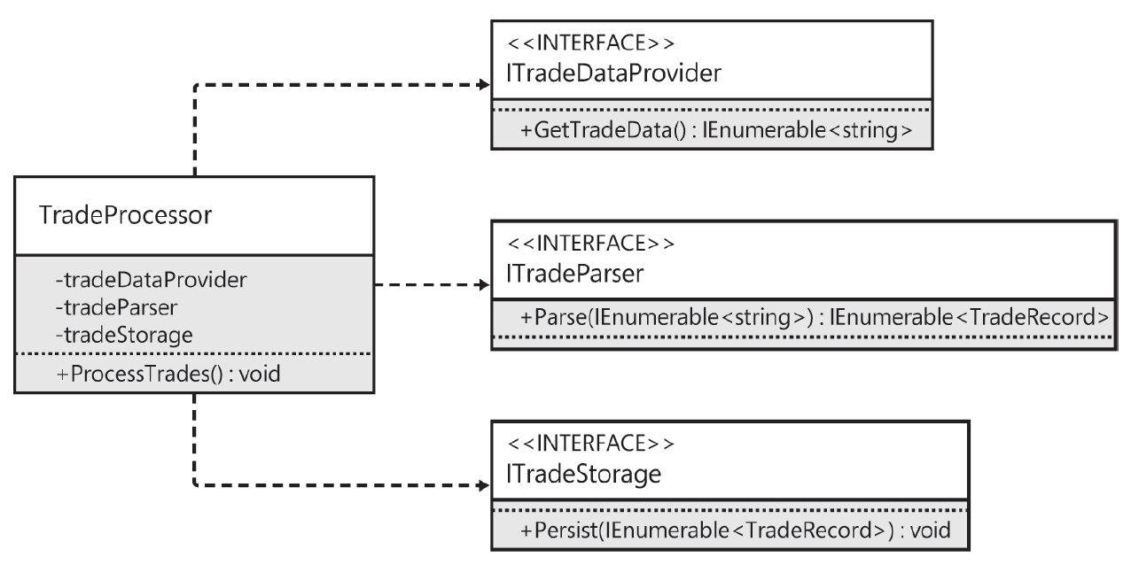
Another Example [5]
public void ProcessTrades(System.IO.Stream stream)
{
var lines = ReadTradeData(stream);
var trades = ParseTrades(lines);
StoreTrades(trades);
}

Slide 16
Why Follow the SRP?
Helps make changing an object easier.

Slide 18
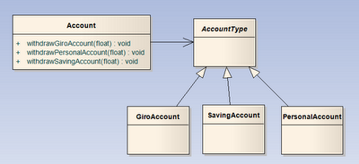

The Open/Closed Principle
Software entities (classes, modules, etc) should be open for extension, but closed for modification. (Add new functionality with minimal modification to existing code. Use plug-ins.)
The open-closed principle says that you should design modules that never change.
When requirements change, you extend the behavior of such modules by adding new code, not by changing old code that already works.

Slide 19
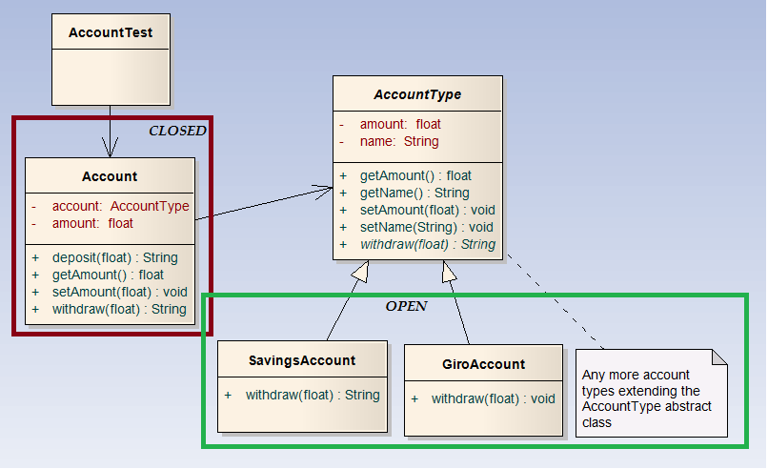
Program to an Interface
Program To An Interface, Not An Implementation.
Using abstraction to gain explicit closure

Slide 20
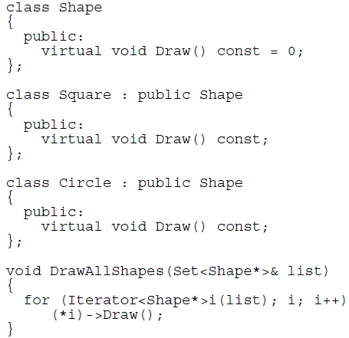
Using a Data-Driven Approach to Achieve Closure
What kind of code would we write to ensure that Circles were drawn before Squares?

Slide 21
Why Follow the OCP?
Helps ensure that objects are easy to extend without requiring change to the original object.

Slide 23
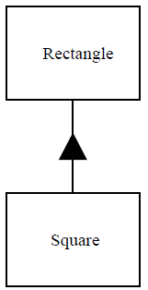
The Liskov Substitution Principle
Derived classes must be usable through the base class interface without the need for the user to know the difference.
class Rectangle
{
public virtual int Width
{
get {return this.width;}
set {this.width = value;}
}
private int width;
public virtual int Height
{
get {return this.height;}
set {this.height = value;}
}
private int height;
}
class Square : Rectangle
{
public override int Width
{
get{ return base.Width; }
set{
base.Width = value;
base.Height = value;
}
}
public override int Height
{
get{return base.Height;}
set{
base.Width = value;
base.Height = value;
}
}
}

Slide 24
?
class ShapeCalculator
{
public int GetArea(Rectangle rectangle)
{
rectangle.Width = 5;
rectangle.Height = 4;
return rectangle.Width * rectangle.Height;
}
}
class Program
{
static void Main(string[] args)
{
Rectangle rectangle = new Rectangle();
ShapeCalculator shapeCalculator = new ShapeCalculator();
Debug.Assert(shapeCalculator.GetArea(rectangle) == 20);
Square square = new Square();
Debug.Assert(shapeCalculator.GetArea(square) == 20);
}
}
The LSP makes clear that in OOD the I SA relationship pertains to behavior.

Slide 25
Why Follow the LSP?

Slide 27
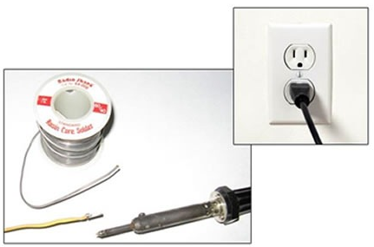
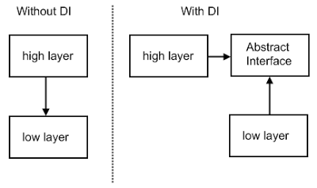
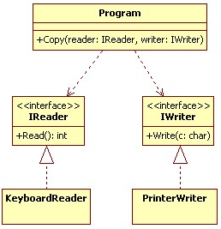
The Dependency Inversion Principle
High-level modules should not depend on low-level modules.
Both should depend on abstractions.
Details should depend upon abstractions. Abstractions should not depend upon details.

Slide 28
Why Follow the DIP?
Helps ensure that objects are highly reusable.
High-level policies and business processes (for example a Domain Model) is what we want to reuse.
If high-level modules depend on the low-level modules changes to the lower level details will force high-level modules to be tested again/to be changed. Additionally, it becomes harder if not practically impossible to use them in other contexts.
It is the high-level modules that should influence the low-level details.

Slide 29
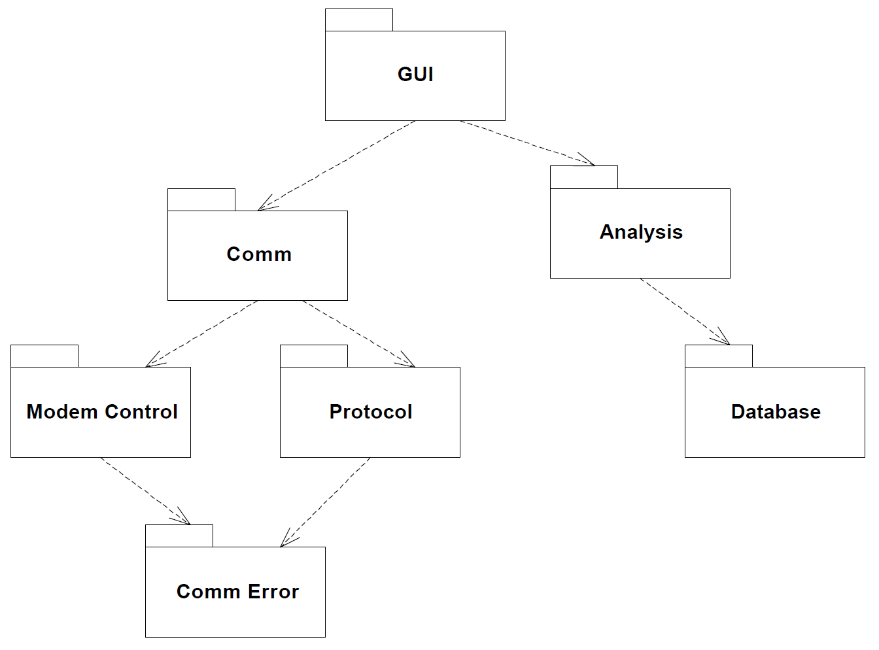
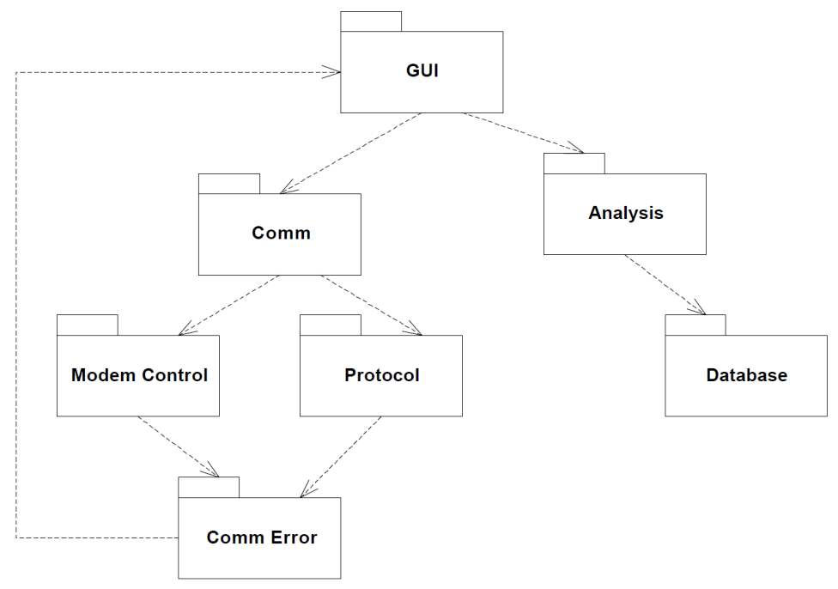
The Acyclic Dependencies Principle [1]

Slide 31
The Law of Demeter Principle
A method "M" of an object "O" should invoke only the methods of the following kinds of objects: O itself; M’s parameters; any objects M creates/instantiates; O’s direct component objects; a global variable, accessible by O, in the scope of M.
F1
FRIENDS
F2
Object O
Method M
F5
F3
F4

Slide 32
Violations: Dataflow Diagram
b.c.foo()
A:b
B:c
foo()
B
C
A
P:q
bar()
A:p
P
Q
p.q.bar ()

Slide 33
OO Following of LoD
M:b.foo2()
foo2() =c.foo()
A:b
B:c
foo()
B
C
A
bar2()=q.bar()
M: p.bar2()
bar()
A:p()
P:q
P
Q
VISITOR Pattern?

Slide 34
Example Code: Issue
String body = String.Format(body, projectManager.FullName, toDo.ToDoList.Project.Name,
toDo.FormattedName, toDo.Status, toDo.Priority.Name, toDo.Duration, toDo.DurationUnit.ToString(), toDo.DueDate, toDo.Assignee.FullName, toDo.PercentComplete, userActioned.FullName, toDo.GetToDoListLink(ApplicationSettings.ApplicationServiceProviderURL), toDo.ApplicationServiceProviderName);
NotificationHelper.Send(ApplicationSettings.EnableSSLForSMTP, ApplicationSettings.DefaultEmail, projectManager.Email, subject, body);

Slide 35
Example Code: Fix
///<summary>
/// Gets Priority Name of the ToDo.
///</summary>
///
public String PriorityName
{
get
{
String priorityName = "N/A";
if (null != this.Priority)
{
priorityName = this.Priority.Name;
}
return priorityName;
}
}

Slide 36
Why Follow the LoD?

Slide 38
Object-Oriented Design [6]
OOD is sometimes taught as some variation of the following:
After identifying your requirements and creating a domain model, then add methods to the appropriate classes, and define the messaging between the objects to fulfill the requirements.
Ouch! Such vague advice doesn't help us, because deep principles and issues are involved.
Examples help. Practice helps.

Slide 39
GRASP
GRASP stands for General Responsibility Assignment Software Patterns.
The name was chosen to suggest the importance of grasping these principles to successfully design object-oriented software.
GRASP defines nine basic OO design principles or basic building blocks in design.

Slide 40
Nine OO Design Principles
Information Expert
Creator
Controller
Low Coupling
High Cohesion
Polymorphism
Pure Fabrication
Indirection
Protected Variations

Slide 41

Thank You & See You Again

